Slide 1
Technology & Patterns of Innovation
Theoretical Base: Schilling (Chapter 3)
Case Study: Tesla Inc. (Rothaermel, 2023)
Focus: Innovation Taxonomies, Technology Patterns, Industry Dynamics

Slide 2
Learning Objectives
By the end of this lecture, you should be able to:
Explain different types of innovation (product, process, radical, incremental, etc.).
Understand patterns of technological change (S-curves, adoption curves, dominant designs).
Apply these to real-world cases (Tesla vs. Apple).
Analyze how innovation types shape industry dynamics.
Critically evaluate open vs. closed innovation in radical contexts.

Slide 3
Outline
What is innovation?
Taxonomies: Types of Innovation (Schilling Ch. 3).
Patterns of Technological Change.
Adoption & Diffusion of Innovations.
Tesla Case: Radical + Open Innovation.
Debate & Class Discussion.
Lessons Learned.

Slide 4
What is Innovation?
Innovation ≠ invention.
Invention = new idea/technology.
Innovation = commercialization & adoption.
Central to: competitive advantage, industry change, societal transformation.
Types & patterns help firms strategize: how radical, how fast, how open.

Slide 5
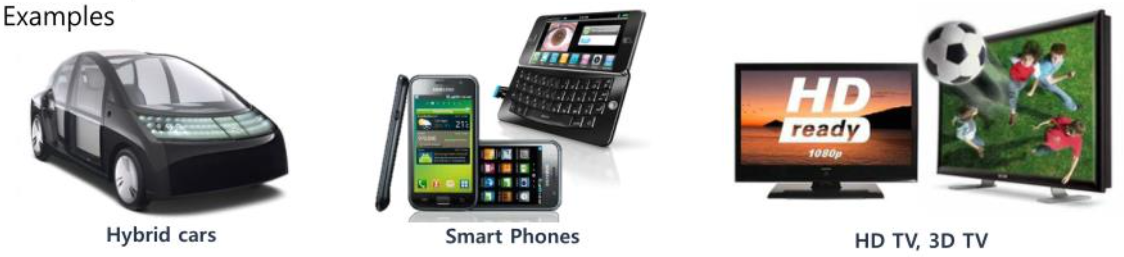
Product vs Process Innovation (Schilling)
Product Innovation:
New/improved goods or services.
Example: Tesla Roadster (product breakthrough).
Process Innovation:
Improvements in production/delivery.
Example: Tesla Gigafactory “machine that builds the machine.”
Often interlinked: better processes enable better products.

Slide 6
Radical vs Incremental Innovation
Radical Innovation
Fundamentally different; may create new industries.
Ex: First iPhone (2007), Tesla EVs.
Incremental Innovation
Minor improvements/refinements.
Ex: iPhone 15 camera; Tesla Model 3 performance tweaks.
Relative concept: Radical for one firm may be incremental for another.

Slide 7
Competence-Enhancing vs Competence-Destroying
Competence-Enhancing: builds on existing skills.
Example: Apple’s chip design (leverages existing strengths).
Competence-Destroying: makes old skills obsolete.
Example: EV drivetrains vs. ICE engines → destroys traditional automaker competences.
Strategic implication: who thrives vs. who fails in disruption.

Slide 8
Architectural vs Component Innovation
Component (Modular): changes in part of a system.
Ex: Tesla’s battery chemistry (component improvement).
Architectural: reconfiguration of whole system.
Ex: Tesla’s EV platform architecture (integrating software + hardware).
Architectural often more disruptive than component.

Slide 9
Framework Summary: Types of Innovation
Dimension | Example: Tesla | Example: Apple
Product vs Process | EV models vs Gigafactory | iPhone vs App Store operations
Radical vs Incremental | Roadster vs Model 3 updates | iPhone launch vs annual upgrades
Competence Enhancing vs Destroying | Enhancing: battery mgmt; Destroying: ICE tech | Enhancing: chip design; Destroying: PC OEM reliance
Architectural vs Component | EV platform vs battery cells | iOS ecosystem vs camera module

Slide 10
Why These Distinctions Matter
Different investment needs (radical = high risk, high reward).
Different capability requirements (destroying vs enhancing).
Different industry effects (incremental sustains incumbents, radical favors entrants).

Slide 11
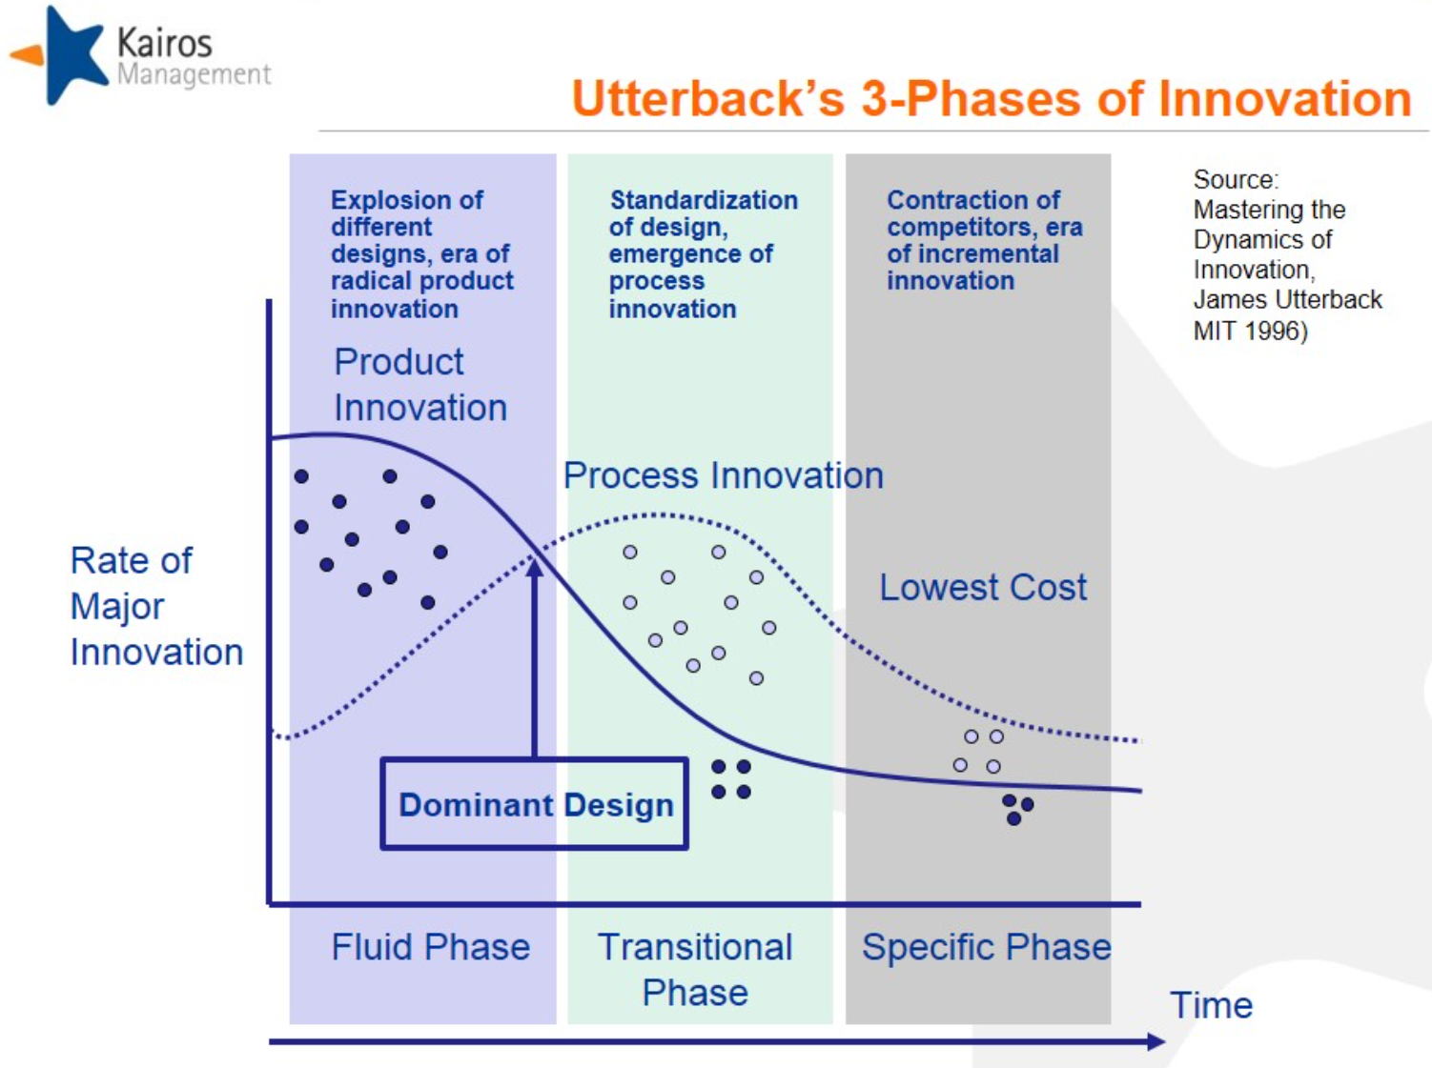
Patterns of Technological Change (Schilling)
Tech evolves in recognizable patterns:
Performance improves in S-curve shape.
Adoption follows S-curve diffusion.
Industries go through cycles (fluid → dominant design → incremental).

Slide 12
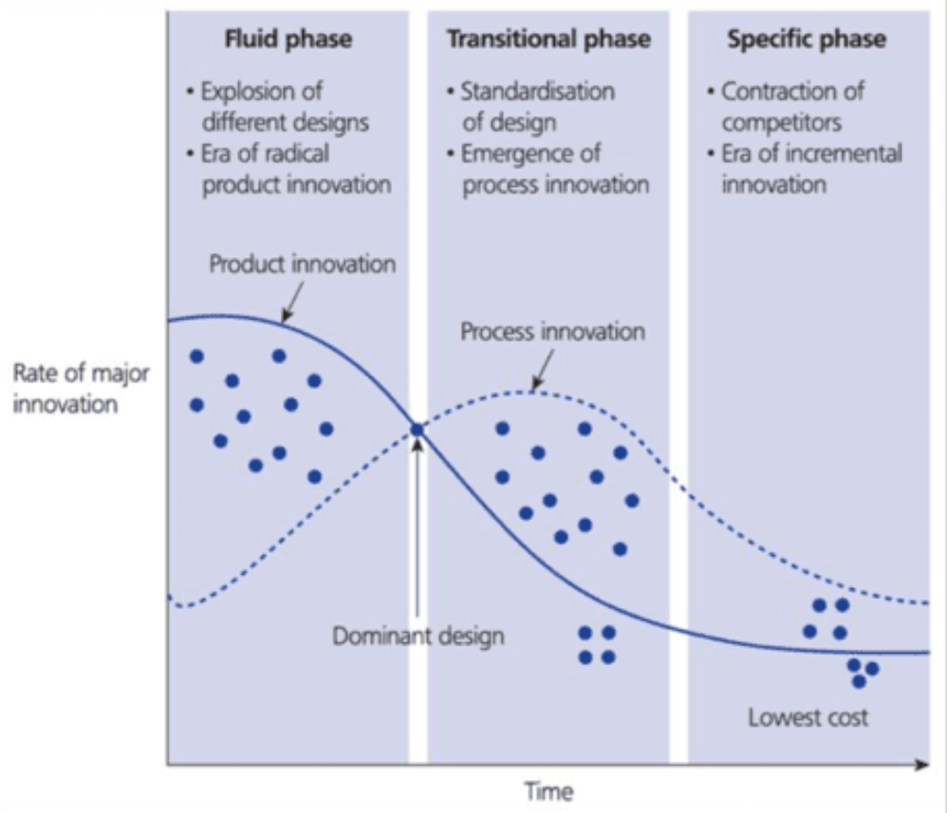
Patterns of Technological Change (Schilling)
Software industry evolves in recognizable patterns:
Performance improves in S-curve shape.
Adoption follows S-curve diffusion.
Industries go through cycles (fluid → dominant design → incremental).

Slide 13
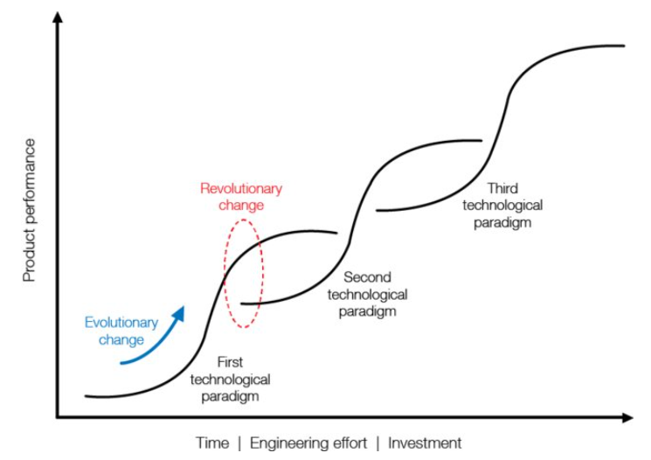
Technology S-Curves (Performance)
Early: slow progress.
Growth: rapid improvements.
Mature: diminishing returns.
Strategic Implication: Firms must know when to jump curves.

Slide 14
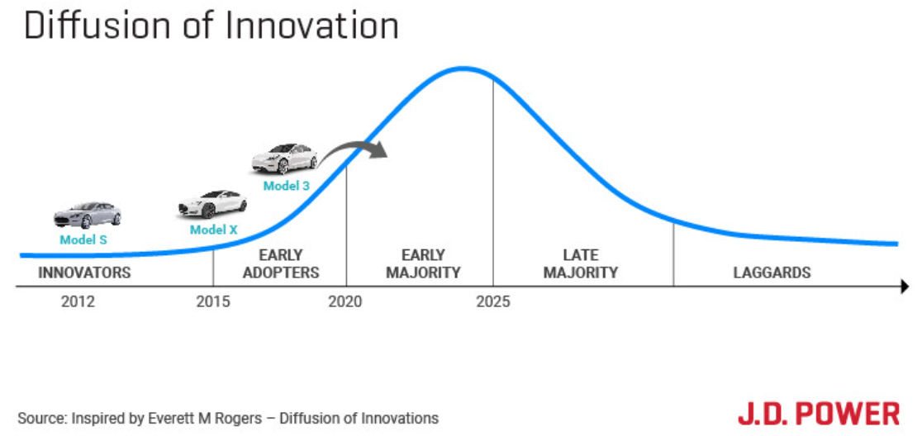
Technology Diffusion S-Curve
Adoption stages: Innovators → Early Adopters → Early Majority → Late Majority → Laggards.
Many technologies fail to “cross the chasm” between early adopters & early majority.

Slide 15
Technology Cycles & Dominant Designs
Cycle: Fluid Phase → Emergence of Dominant Design → Era of Incremental Change.
Tesla example:
Fluid: 2008 Roadster (proof of concept).
Dominant design emerging: affordable EV sedan (Model 3).
Incremental: Model Y, Cybertruck tweaks.

Slide 16
Limitations of S-Curve Models
Descriptive, not predictive.
Hard to locate the exact inflection point.
External shocks (e.g., regulation, geopolitics) alter trajectories.

Slide 17
Case Integration: Tesla Inc. (Rothaermel 2023)
Radical product + process innovation.
Vertical integration: batteries, software, manufacturing.
Open patents: accelerate EV ecosystem.
Master Plans: sequential roadmap for innovation and scaling.

Slide 18
Tesla Master Plan I (2006)
Roadster → Model S → Model 3.
Profits reinvested to scale down price points.
Vision: mass adoption of sustainable transport.

Slide 19
Tesla Master Plan II (2016)
Expand to trucks & SUVs.
Integrate solar & storage.
Autonomy & shared mobility.
Radical + architectural innovation.

Slide 20
Tesla Master Plan III (2023)
Goal: global sustainable energy transition.
EV + renewables + heat pumps + industrial electrification.
Industry-shaping, system-level innovation.

Slide 21
Tesla’s Vertical Integration
Controls:
Batteries, AI chips, OTA software, manufacturing, sales.
Benefits:
Speed, quality control, resilience (e.g., chip shortage).
Drawback:
Huge capital intensity.

Slide 22
Tesla’s Open Patent Strategy (2014)
Musk: “Open patents for good faith use.”
Logic: grow the entire EV pie.
Competence-destroying for ICE incumbents, competence-enhancing for EV ecosystem.
Risk: rivals gain knowledge.

Slide 23
Tesla Through Schilling’s Taxonomy
Product + Process innovation combined.
Radical early, incremental later.
Competence destroying for ICE rivals.
Architectural redesign of automobile.

Slide 24
Apple’s Contrast: Closed Ecosystem
Closed, competence-enhancing innovations.
Incremental product upgrades.
Architectural lock-in (iOS + App Store).
Strong profitability, slower diffusion vs. Tesla’s openness.

Slide 25
Ethical & Societal Issues
Tesla: sustainability vs. labor exploitation, data privacy in autonomy.
Apple: walled gardens, repair restrictions, supply chain ethics.
Open vs closed has moral and societal consequences.

Slide 26
Class Activity: Debate Setup
Debate: “Does open innovation weaken competitive advantage?”
Pro side: Weakens IP control, helps competitors.
Con side: Grows ecosystem, accelerates adoption, strengthens leadership.

Slide 27
Debate Instructions
Form 2 groups.
Prep 10 mins, Present 2 mins each.
Rebuttals + open class voting.
Instructor links back to Schilling’s frameworks.

Slide 28
Discussion Questions
How do Tesla’s innovations fit Schilling’s taxonomy?
What risks do radical + open strategies pose for incumbents?
Could Apple succeed in EVs with a closed model?
Do industry dynamics favor open or closed innovation in sustainability?

Slide 29
Lessons Learned
Innovation dimensions shape industry outcomes.
Technology follows recognizable patterns (S-curves, cycles).
Tesla illustrates radical, open, architectural innovation.
Apple illustrates closed, incremental, competence-enhancing innovation.
Strategic alignment matters: no one “best” model.

Slide 30
Wrap-Up & Next Steps (continued)
Firms must understand what type of innovation they are pursuing, and where they are on the technology trajectory
Innovation dimensions:
Product vs. Process
Radical vs. Incremental
Competence-Enhancing vs. Destroying
Architectural vs. Component

Slide 31
Wrap-Up & Next Steps
Technology Patterns:
S-Curve Performance: EV range and cost improvements
Diffusion S-Curve: Adoption shift from innovators to the early majority
Technology Cycles: Industry converging toward dominant design

Slide 32
Readings
Malissa A. Schilling. (2022). Strategic Management of Technological Innovation. Chapter 3
Rothaermel. (2023). Tesla, Inc. case study

